Slide 1
Da 251M Course PROJECT

Slide 2

AIM
To enhance image quality using a static image processing model that leverages mathematical techniques such as histogram equalization and gamma correction. This model aims to improve clarity, boost texture detail, and minimize noise in images degraded by low illumination and challenging environmental conditions, enabling clearer visual analysis and interpretation

Slide 3
Image COmponents
Brightness: Adjusts the overall lightness or darkness of an image,
influencing its visibility in different lighting conditions.
Contrast: Enhances the difference between light and dark areas in
an image, helping to highlight details and depth.
Sharpness: Refines the clarity of edges and fine details in an image,
improving its perceived definition.
Pixel: The smallest unit of an image, each pixel holds color or intensity
information that collectively forms the complete image.

Slide 4
Primary FOCUS
We have primarily focused on enhancing the contrast of the image by applying gamma correction and histogram equalization methods. These techniques help in adjusting the image’s brightness distribution and improving the visibility of details, particularly in low-light and high-contrast scenes

Slide 5
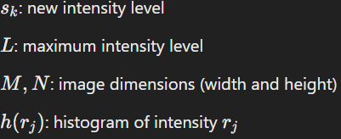
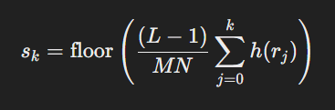
Histogram Equalization
Objective: Redistribute pixel intensities to enhance contrast.
Process: Uses the cumulative distribution function (CDF) of pixel intensities to
map original intensities to a new, equalized distribution.
Effect: Spreads out frequently occurring intensities, making details in darker
or brighter regions more visible.

Slide 6
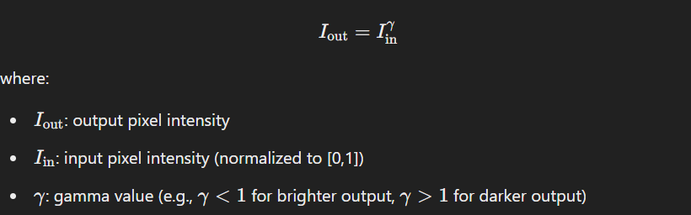
Gamma Correction
Objective: Adjusts the brightness of an image non-linearly.
Process: Applies a gamma value γ to control brightness, especially useful for handling shadows and highlights.
Effect: Enhances contrast by brightening shadows or dimming highlights, achieving a more balanced image.

Slide 7
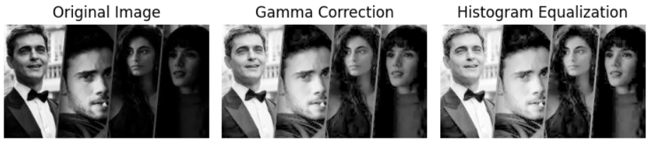
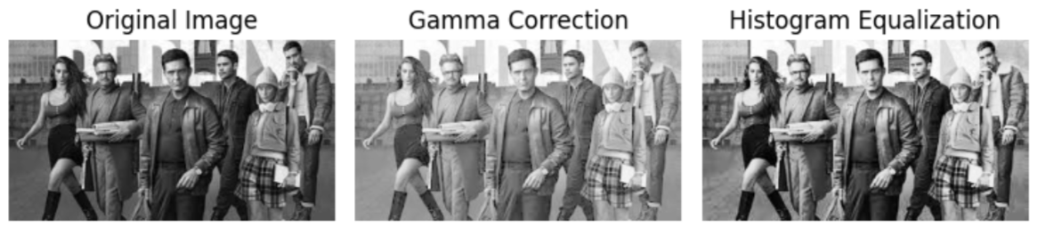
RESULTS:

Slide 8
CONCLUSION
Gamma Correction: This method adjusts the image brightness non-linearly, which can enhance details in darker regions without overexposing brighter areas. However,
the results may vary depending on the gamma value chosen, and fine-tuning is often required. In this case, Gamma Correction moderately brightens the image, revealing some details in the darker regions while maintaining the overall tonal balance.
Histogram Equalization: This technique redistributes the pixel intensity values, enhancing contrast throughout the image. It improves visibility in both light and dark areas, making details more pronounced. In the image shown, Histogram Equalization effectively enhances contrast, making facial features and textures more distinguishable compared to the original and gamma-corrected versions

Slide 9
Thank you
Kanav Bansal 230123029
AADI Poddar 230123001
Khushhal Bansal 230123031
PRATIK RANJAN 230123046

